Slide 1


InControl – PSD2 powered

Slide 2
Who we are
Indice is a software house founded and based in Athens. We are a team of software architects, engineers, testers and ux experts.
Our success in the services arena enables us to branch out our focus to innovative software products.

Slide 3
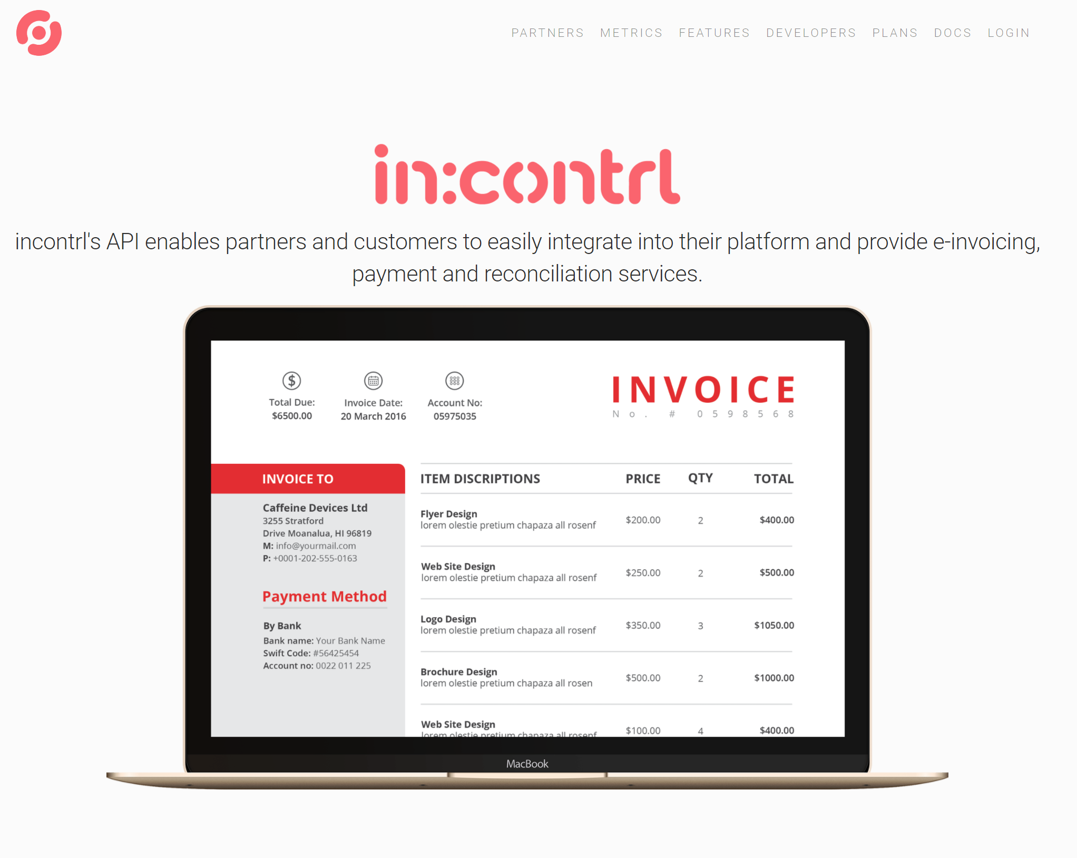
Why we are here

Slide 4
Why we are here
InContrl is an e-invoicing platform, developed in .NET and hosted on the Azure cloud platform.
API-first, meaning customers can integrate it into their own tools and processes
One of its benefits is integration with the business’ bank account, offering automatic or semi automatic reconciliation
PSD2 offers a standardized and mandatory means of accessing transaction data

Slide 5

Reconciliation
Reconciliation is the process of ensuring that two sets of records (usually the balances of two accounts) are in agreement. incontrol’s bank reconciliation is the process of matching transactions from your bank accounts, with accounts payable (customer obligations).

Slide 6
Market fit
Any company with high volume of accounts payable and multiple payment channels that need to streamline the reconciliation process.
ISV’s that need to enhance their products with bank transactions reconciliation features.

Slide 7
Hackathon milestones achived!
Incontrl already supports CSV import of transactions. Developed a transaction provider based on NBG’s open bank API
Add API abstractions such as bank provider settings, api urls, per-subscriber API keys etc.
Import transactions from the NBG sandbox directly through the existing inContrl API
i.e. from GET https://apis.nbg.gr/public/nbgapis/obp/v3.0.1/accounts/{account_id}/transactions
to POST https://api-vnext. api.incontrl.io/subscriptions/{subscriptionId}/bank-accounts/{bankAccountId}/transactions
Reconcile transactions with existing invoices
Explore means of direct payment of a subscriber invoice from the end-customer (credit card integration/PSD2 direct debits, others).

Slide 8
Thank you!

